Slide 1



CRUD Operations in MongoDB

Slide 2

MongoDB as Document-Based Database

Slide 3

Objectives
Discuss MongoDB data types
Working with different data models
Explain advanced CRUD operation

Slide 4

Objectives
Describe Data Model Design
Describe data model examples and patterns

Slide 5
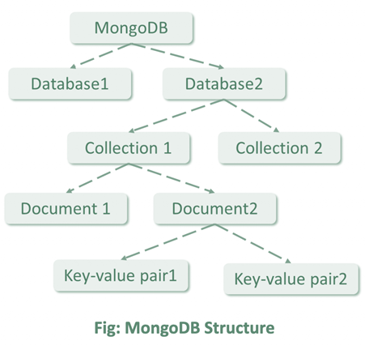
MongoDB Introduction
MongoDB is an open-source database management system (DBMS) that uses a document-oriented database model which supports various forms of data.

Slide 6

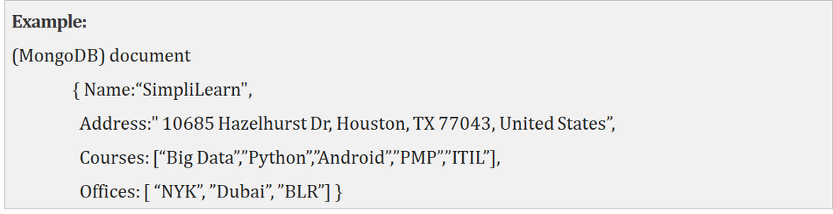
Document Database
Document Database stores and retrieves various documents in JSON, XML, and BSON.
Examples of Document databases are MongoDB and Apache CouchDB.

Slide 7
MongoDB Data Types

Slide 8
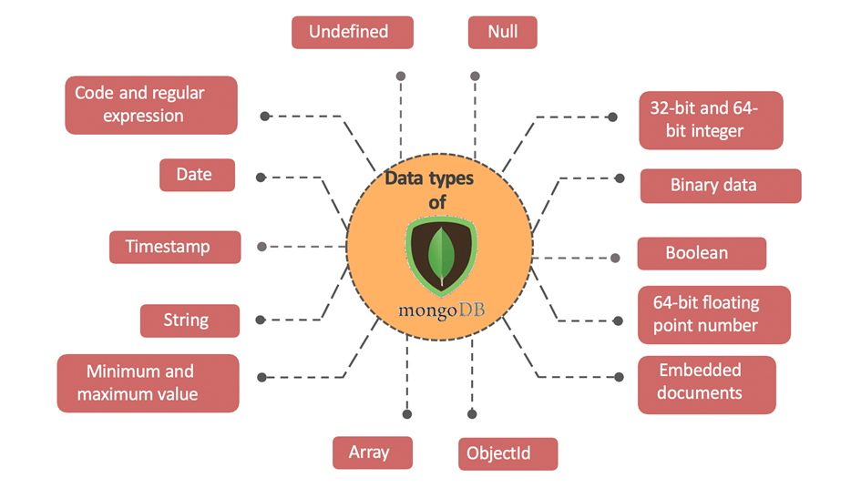
MongoDB Data Types

Slide 9
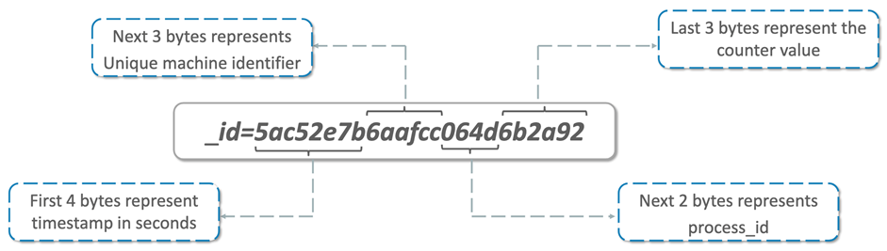
MongoDB: ObjectID
Each document must have unique identifier, which is used to save some document from the database.
These identifiers are symbolized as “_id”.
An ID is defined using ObjectID, which is generated automatically after creation of any document.
ObjectID is 12 bytes of binary string or number having following structure.

Slide 10
MongoDB Data Models

Slide 11
What is Data Modelling?
Data Modelling is the process to structure and organize the data in better way.
It is defined based on the business flow.
Data Modelling helps to convert business flow into data structure flow.

Slide 12
Data Modelling Layers
Conceptual Data Modelling
High level relationships among entities
Logical Data Modelling
Entities, attributes, and relationships involved in a business function
Physical Data Modelling
Implementation of a logical data model

Slide 13
Data Modelling Layers
Feature | Conceptual | Logical | Physical
Entity Names | ✓ | ✓
Entity Relationships | ✓ | ✓
Attributes |  | ✓
Primary Keys |  | ✓ | ✓
Foreign Keys |  | ✓ | ✓
Table Names |  |  | ✓
Column Names |  |  | ✓
Column Data Types |  |  | ✓

Slide 14

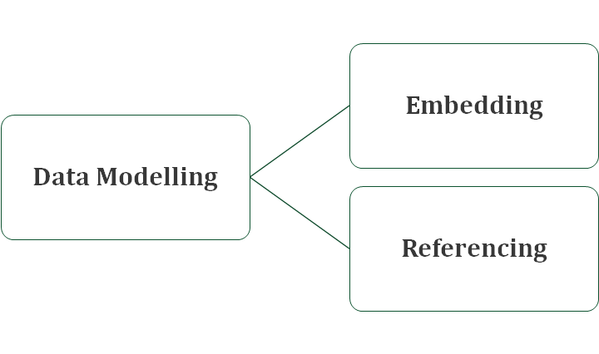
MongoDB
Data Modelling Tools

Slide 15
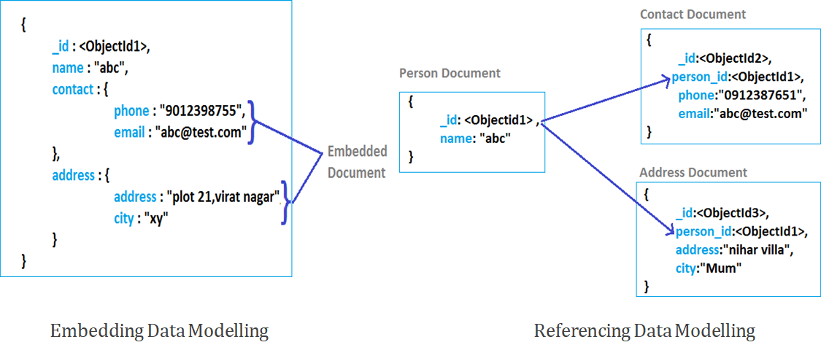
MongoDB Embedding And Referencing

Slide 16
Data Modifications in MongoDB

Slide 17
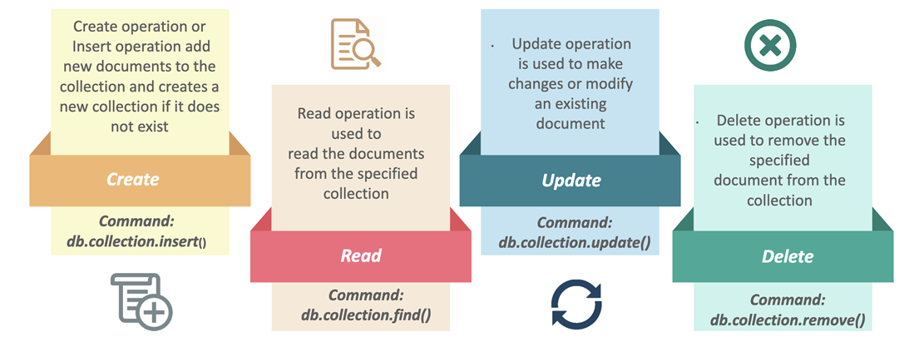
CRUD Operations in MongoDB
CRUD (Create, Read, Update, Delete) Are used to manage data/document within database.

Slide 18
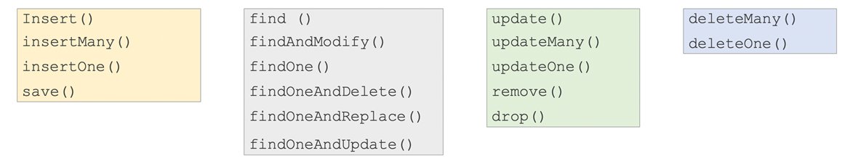
MongoDB Advanced CRUD Operations
Insert Methods
Find/Retrieve Methods
Update Methods
Delete Methods

Slide 19
Advance Query Operations

Slide 20
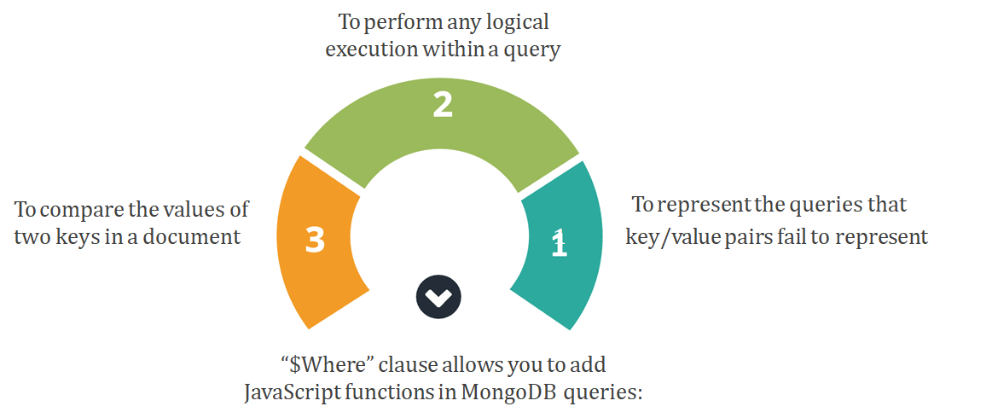
MongoDB Advanced CRUD Operations

Slide 21
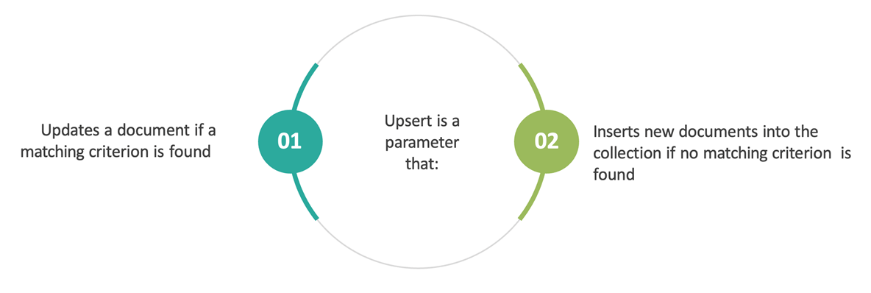
MongoDB Advanced CRUD Operations

Slide 22
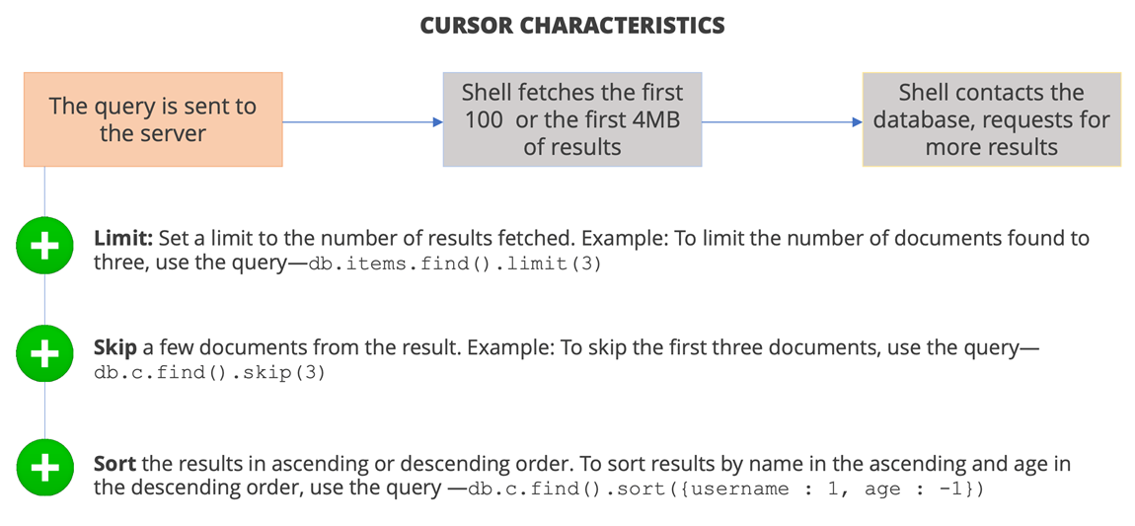
MongoDB Advanced CRUD Operations

Slide 23
Different MongoDB Operators

Slide 24
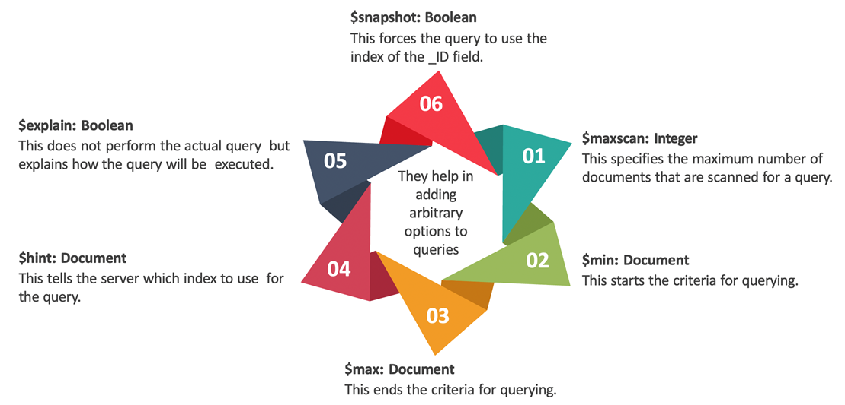
MongoDB Advanced CRUD Operations

Slide 25
Thank You!

